Slide 1
Ecosystem Sources

Slide 2
Source 1: Video

Slide 3
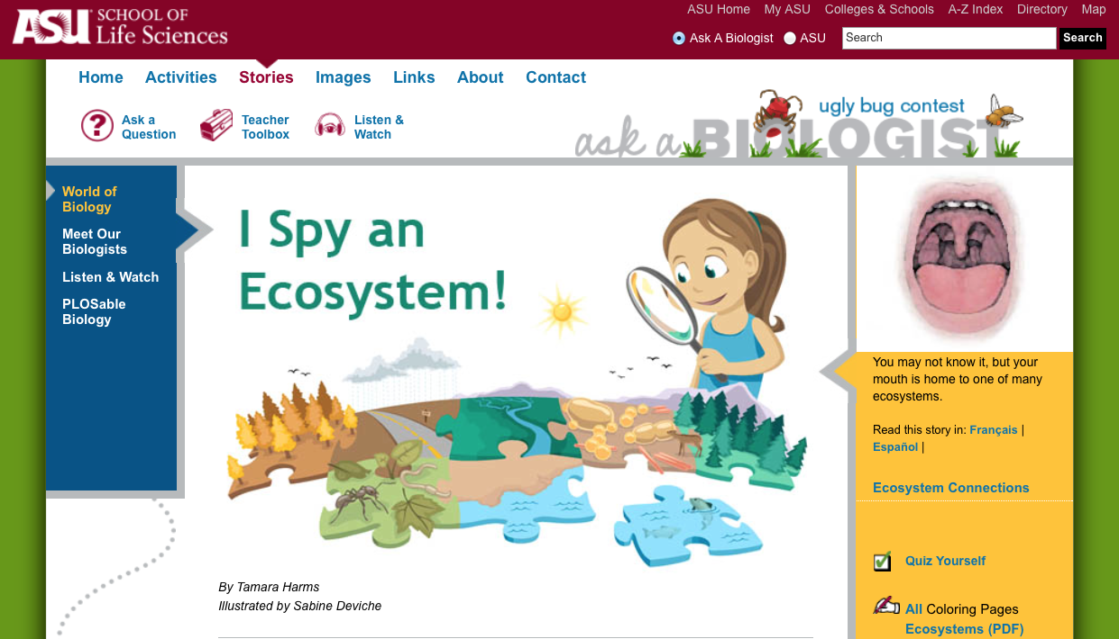
Source 2: Click Here

Slide 4
Source 3: Click Here (First two pages)

Slide 5
Source 4: Click Here

